Slide 1
Hypnotherapy in integrated primary care: A Rural FQHC Experience
David A. Arena, Psy.D., J.D., M.A., MBA, M.Ed., LPC, NBFCCH

Slide 2
Disclosure
I have no actual or potential conflict of interest in relation to this program/presentation.

Slide 3
AGENDA
What is hypnosis/hypnotherapy?
Uses of hypnotherapy
Myths and Misconceptions
Evidence basis for hypnotherapy
Application in a rural setting
Q & A

Slide 4
Quote of the day
“A therapist provides an atmosphere, a climate for change. A therapist is the weather.”
--Milton H. Erickson

Slide 5
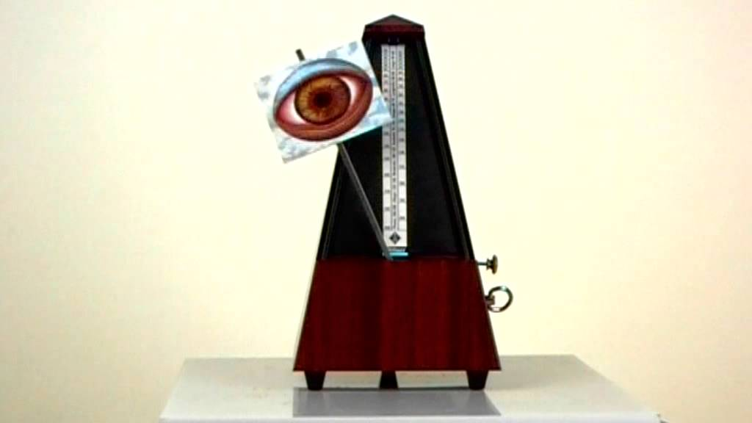

Slide 6
What is hypnosis ?
“Guided imagery on steroids”
--Arena, 2017
“A massage for my brain”
--Anonymous client, 2012

Slide 7
What is hypnosis ?
Hypnosis was one of the earliest mind-body interventions to be used in medical settings, and was originally performed for pain relief during surgical procedures in eras without effective pharmacological analgesia (Esdaile, 1957 cited in Yeh et.al., 2014).

Slide 8
What Is Hypnosis ?
Altered state of consciousness– not sleep, but naturally occurring dissociative state
Highway hypnosis
Books and TV
Exercise
Day dreaming

Slide 9
What Is Hypnosis ?
Hynpnogogia –the state that immediately precedes the onset of sleep
Hypnopompic state—the state that immediately precedes waking from sleep

Slide 10
What is Hypnosis ?
Hypnosis has been defined variously, and often simultaneously, as:
a state,
trait,
procedure,
process,
therapy,
sociocognitive construct,
and everything we do with those in our care.
(Sugarman, 2015, p. 209-10).

Slide 11
What Is Hypnosis ?
The American Psychological Association, Division of Psychological Hypnosis (2014) definition:
Hypnosis: A state of consciousness involving focused attention and reduced peripheral awareness characterized by an enhanced capacity for response to suggestion.
Hypnotic induction: A procedure designed to induce hypnosis.
Hypnotizability: An individual's ability to experience suggested alterations in physiology, sensations, emotions, thoughts or behavior during hypnosis.
Hypnotherapy: The use of hypnosis in the treatment of a medical or psychological disorder or concern.

Slide 12
What Is “not” Hypnosis ?
A person's ability to experience hypnotic suggestions can be inhibited by fears and concerns arising from some common misconceptions.
Contrary to some depictions of hypnosis in books, movies or television, people who have been hypnotized do not lose control over their behavior.
They typically remain aware of who they are and where they are, and unless amnesia has been specifically suggested, they usually remember what transpired during hypnosis.
Hypnosis makes it easier for people to experience suggestions, but it does not force them to have these experiences.

Slide 13
The Trance State
Light hypnosis – 90%+ of people experience:
Eye closure
Fluttering lids/REM
Stillness
Breathing slows
Features flatten
Swallowing
Smiling
Bradycardia

Slide 14
The Trance State
Medium hypnosis – 70%+ can experience:
Head drops
Eyelid catalepsy
Flushing or pallor
Responds to suggestions
Feeling of lethargy, heaviness
Some analgesia
IMR (ideomotor response e.g. Finger or arm levitation)
May feel as though in trance

Slide 15
The Trance State
Deep hypnosis 20%
Amnesia
Anaesthesia
Out of body dissociation
hallucinations
Trance with eyes open

Slide 16
Uses of Hypnotherapy
Behavioral problems
Smoking
Weight loss
Eating disorders – bulimia, anorexia, binge eating
Enuresis
Psychological problems
Anxiety
Panic
Phobias
Insomnia
Premature ejaculation
Vaginismus

Slide 17
Uses of Hypnotherapy
Psychosomatic disorders
Migraine
Hyperventilation
Stammering
Irritable bowel/bladder
Eczema
Pain control
Chronic
Acute
Terminal care
Obstetric
Dental

Slide 18
Uses of Hypnotherapy
Other
Sports – motivational
Criminal investigation
Recovery of lost objects - memories

Slide 19
Myths and Misconceptions (Torem, 1992)
Hypnosis is sleep.
The Greek word "hypno" means sleep. However, the EEG patterns of hypnotic trance are totally different from the EEG patterns of sleep
(https://www.ncbi.nlm.nih.gov/labs/articles/1549744/)

Slide 20
Myths and Misconceptions (Torem, 1992)
Hypnosis occurs only when induced by a hypnotherapist.
A hypnotic trance is a naturally occurring phenomenon that people go in and out of everyday. It is called "spontaneous hypnosis".

Slide 21
Myths and Misconceptions (Torem, 1992)
Only people of weak character can be hypnotized.
The opposite has been found to be true. People with severe mental illnesses are associated with a lower hypnotic capacity. In fact, it has been demonstrated that higher hypnotic capacity is a sign of health.

Slide 22
Myths and Misconceptions (Torem, 1992)
Women are more hypnotizable than men.
This myth is associated with the outdated notion that women are more weak minded, passive and dependent than men. In fact, women and men are equally hypnotizable.

Slide 23
Myths and Misconceptions (Torem, 1992)
A person can get "stuck" in a trance.
In healthy people who do not suffer from a major mental illness, it is impossible to get "stuck" in trance.

Slide 24
Myths and Misconceptions (Torem, 1992)
Once a person has been hypnotized, he/she can no longer resist it.
This stems from the belief that the hypnotherapist is in control of the person. In reality, the person can come out of trance anytime they want to. And, they can choose not to go into trance.

Slide 25
Myths and Misconceptions (Torem, 1992)
A successful hypnotherapist must be unique, charismatic or weird.
This myth is perpetuated by stage hypnotists who wish people to believe they have magical powers. Success as a hypnotherapist rests more on skills in interpersonal communication and the ability to put people in a safe atmosphere of comfort.

Slide 26
The Ability to be Hypnotized Varies with Age
Cross-sectional studies of different age groups show a developmental curve, with very young children relatively unresponsive to hypnosis.
Longitudinal studies indicate that hypnotizability assessed in college students remains about as stable as IQ over a period of 25 years (Kihlstrom, 2000).

Slide 27
Who benefits less?
1. People with abnormally low IQ's (attention and response-time factors)
2. Dementia patients (these patients cannot be hypnotised due to problems in prefrontal areas necessary to process induction signals)
3. People who score low (9%) on scales of hypnotisability
4. People for whom condition brings secondary gains (conscious or unconscious pay-offs)
5. People in psychotic states. (Can uncover too much material and therapist can be drawn in to any delusional beliefs)
6. People in hypermanic states

Slide 28
Cross Cultural APPLICATION (YEH AT AL 2014)
There are studies that support responsiveness to hypnosis across cultural groups. A large body of research has examined the extent to which hypnotic suggestibility potentially differs across cultural samples.
The comparable distribution of hypnotic suggestibility in multiple cultures, ethnic and racial groups supports the idea that hypnotic responses are likely similar across these groups.
Further, randomized controlled trials of hypnosis that were conducted in ethnically and racially diverse samples have demonstrated that treatment efficacy does not differ as a function of ethnic or racial group identification (Montgomery & Bovbjerg, 2004; Montgomery et al., 2007; Montgomery et al., 2014).

Slide 29
What Happens During Hypnosis?
A typical hypnosis session begins with an induction procedure in which the person is asked to focus his or her eyes on a fixation point, relax, and concentrate on the voice of the hypnotist.
Although suggestions for relaxation are generally part of the hypnotic induction procedure, people can respond positively to hypnotic suggestions while engaged in vigorous physical activity.
The hypnotist then gives suggestions for further relaxation, or a deepening, with focused attention, and often eye closure.
After the person’s eyes are closed, further suggestions for various imaginative experiences are given.
Posthypnotic suggestions may also be given for responses to occur after hypnosis has been terminated.

Slide 30
Dangers?
Controversy exists among the experts, but most stress that hypnosis and hypnotic techniques are safe.
Considering the number of lay hypnotists practicing on stage and in "hypnosis" clinics, it is amazing how seldom one hears of adverse consequences.

Slide 31
Dangers?
Additional dangers, to the clinician cited by Crasilneck and Hall include:
excessive grandiosity about the potential of hypnosis
narrowing one's practice to the use of hypnosis exclusively
psychopathological disturbances, e.g., an amateur hypnotist became obsessed with supposed telepathic experiences
having unrealistic expectations.

Slide 32
Dangers?
These dangers are similar to the dangers faced by other clinicians, particularly psychotherapists.
They accompany any psychotherapeutic relationship and are most often understood as transference-countertransference reactions.
In summary, caregivers are not to use hypnosis and/or hypnotic techniques indiscriminately with all patients but can be a valuable tool used within a therapeutic relationship and with a clear understanding of the patient's problem and coping capacities.

Slide 33
Is it evidence-based?
Modern research has continued to demonstrate therapeutic effects of hypnosis. Hypnosis is considered an evidence-based intervention for chronic pain associated with cancer (NIH technology assessment, 1996) and numerous meta-analyses have found that hypnosis can reduce a wide variety of medical symptoms and side effects. For example, hypnosis can:
reduce pain, distress, and other side effects arising from medical or surgical procedures
help control cancer treatment-related side effects such as nausea, vomiting, and fatigue
help manage the symptoms of irritable bowel syndrome (IBS)
(Yeh, 2014).

Slide 34
Evidenced Based (Roberston, 2009)

Slide 35
Is it evidence-based?
“Possible” empirically-supported treatments
8. Acute pain (adult) |  | Patterson & Jensen, 2003
9. Acute pain (children) | Hypnosis > distraction for bone marrow aspiration | Zeltzer & LaBaron, 1982
10. Anorexia | Staged treatment with hypnosis > same without hypnosis | Baker & Nash, 1987
11. Anxiety about public speaking | Hypnosis > CBT | Schoenberger et al., 1997
12. Anxiety about taking a test | Self-hypnosis>discussion control | Stanton, 1994
13. Asthma | Hypnosis>attention control | Ewer & Stewart, 1986
14. Bed wetting | Suggestion with or without hypnosis > wait list control | Edwards & Van der Spuy, 1986
15. Bulimia | Hypnosis = CBT > wait list | Griffiths et al., 1996
16. Chemotherapy distress | Hypnosis>conversation + antiemetic medication | Jacknow et al., 1994
17. Cystic fibrosis | Self-hypnosis>wait list control | Belsky & Khanna, 1994
18. Depression | Hypnosis enhances CBT | Alladin & Alibhai, 2007
19. Duodenal ulcer relapse | Hypnosis + medication > medication only | Colgan et al., 1988
20. Fibromyalgia | Hypnosis > physical therapy for subjective symptoms | Haanen et al., 1991
21. Haemorrhage | Preoperative suggestion reduces blood flow | Enqvist et al., 1995
22. High blood-pressure | Hypnosis > wait list in reducing BP long-term | Gay, 2007
23. Hip or knee osteoarthritis pain | Hypnosis = relaxation > wait list control | Gay et al., 2002
24. Insomnia (primary) | Hypnosis + CBT > medication long-term | Graci & Hardie, 2007
25. Irritable bowel syndrome (IBS) | Hypnosis > psychotherapy | Whorwell et al., 1984
26. Nausea & hyperemesis | Hypnotic-like relaxation > control | Lyles et al., 1982
Robertson (2009)

Slide 36
More reading on effectiveness

Slide 37
Underused and underrespected
Overall, hypnosis remains underused despite evidence supporting its beneficial clinical impact (Yeh et.al., 2014).
“…why is hypnosis basically the “crazy cousin that nobody wants at the family picnic”?
How is it that we continue to be marginalized by the rest of the helping professions?” (Yapko, 2014).

Slide 38
A Few SeLECT RECENT CASES
68/female--giant cell arteritis, OCD, GAD, PTSD—remote control movie theater
38/male—smoking cessation and anger management—letting go of resentment
44/male—chronic pain, acute pancreatitis, PTSD, divorced—acceptance
77/male—chronic pain, arthritis, MDD, death of spouse of 56 years—tying flies
59/female—unable to swallow any solid food—daughter murdered
22/male—panic disorder/agoraphobia—work in progress

Slide 39
QUESTIONS ??????

Slide 40
references
Cowen, L. (2016). Literature review into the effectiveness of hypnotherapy. Australian Counseling Research Journal, 10(1), 1-55.
Hartman, David & Zimberoff, Diane. (2013). Jung and Hypnotherapy. Journal of Heart-Centered Therapies,16(1), 3-52.
Hope, A.E. & Sugarman, L.I. (2015). Orienting hypnosis. The American Journal of Clinical Hypnosis, 57, 2012-229.
Landry, M. & Raz, A. (2015). Hypnosis and imaging of the living human brain. American Journal of Clinical Hypnosis, 57, 285–313.
Robertson, D. (2009). Which forms of hypnotherapy are evidenced-based? The Hypnotherapy Journal, Spring.
Sugarman, L. I. (2015). Mapping the domain of hypnosis. The American Journal of Clinical Hypnosis, 57, 209-211.
Yapko, M.D. (2014). The spirit of hypnosis: Doing hypnosis versus being hypnotic. The American Journal of Clinical Hypnosis, 56, 234-248.
Yeh, V .M., Schnur, J .B.. & Montgomery, G. H. (2014). Disseminating hypnosis to health care settings: Applying the RE-AIM framework. Psychology of Consciousness: Theory, Research, and Practice, 1(2), 213-228

Slide 41
My contact information
David A. Arena, Psy.D., J.D., M.A., MBA, M.Ed., LPC, NBFCCH
Director of Behavioral Health Services
118 Moosehead Trail, Ste. 5, Newport, ME 04953
Toll-free: 1-866-364-1366
Hometown Health Center
118 Moosehead Trail, Suite 5
Newport, PA 04953
David.Arena@hhcme.org
1-866-364-1366
Cell (207) 416-5908

